Slide 1

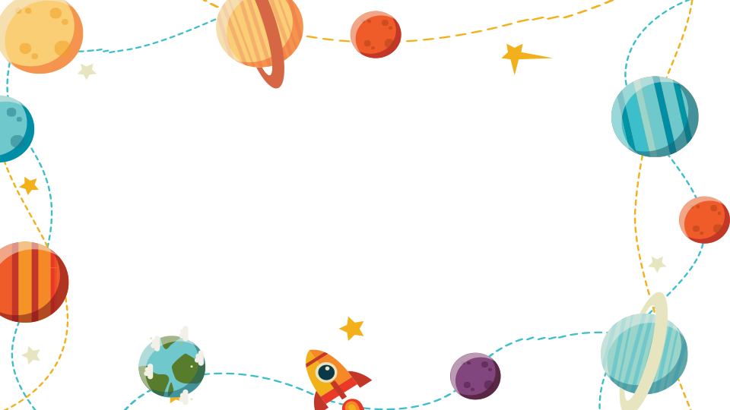

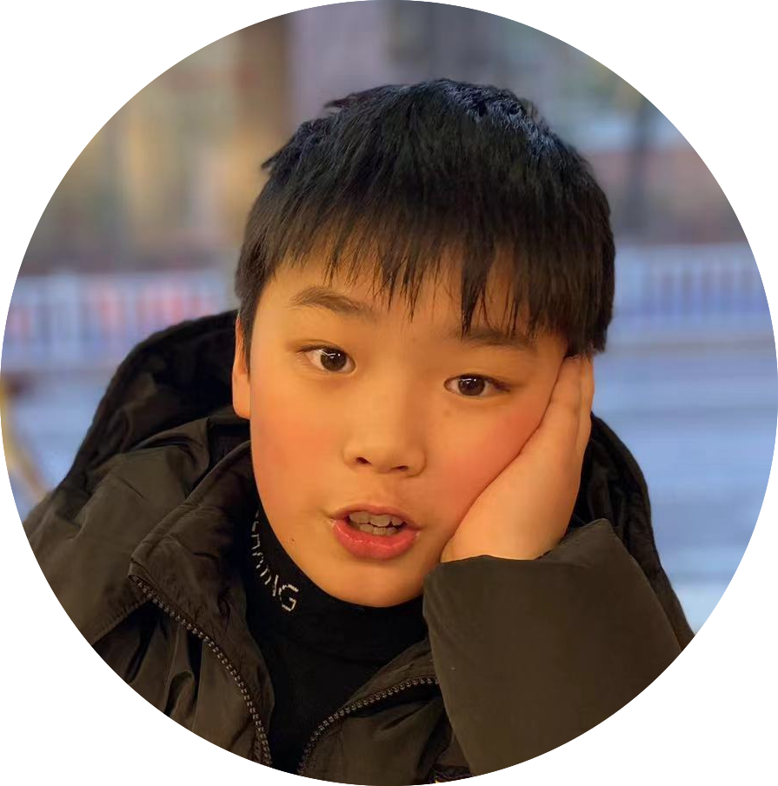
My family hobby
Class 4, Grade 5
--- Grant

Slide 2

Name：Grant
Old：eleven
Sex：boy
Birth： March 21, 2012
Constellation ： Aries

Slide 3
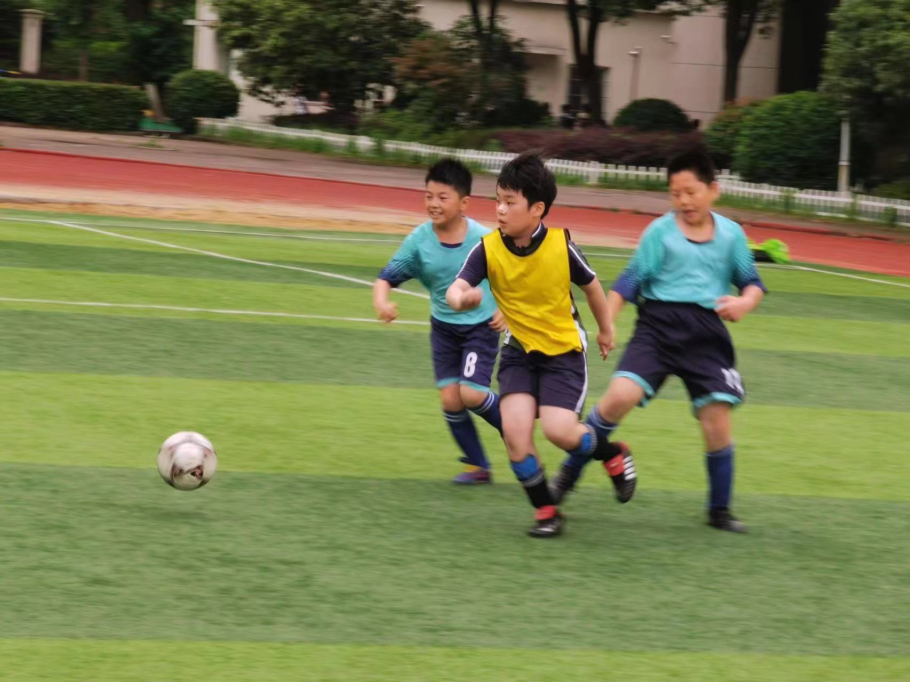
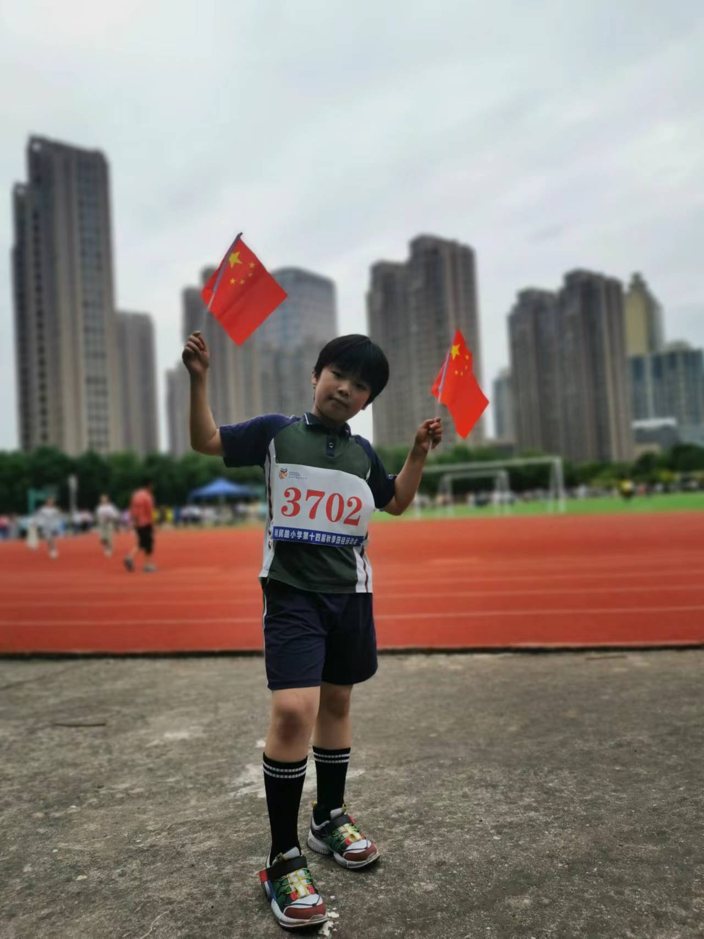

GRANT
This is me.
I like playing basketball and football.
I am good at these.
I also like playing table tennis.

Slide 4
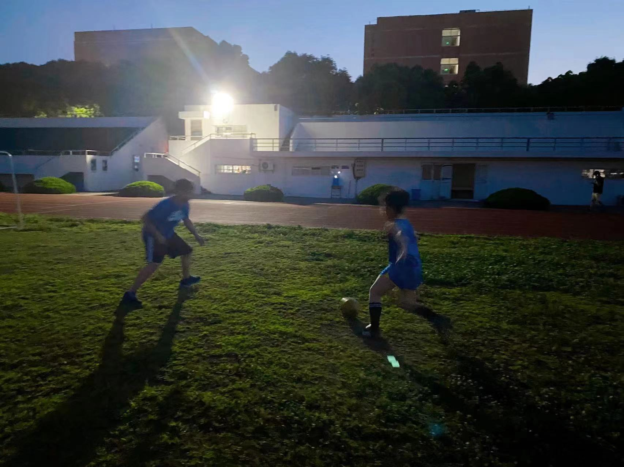
FATHER
This is my father.
He likes playing basketball too.
He is good at it.
He often play basketball in the playground.
He also like swimming.

Slide 5

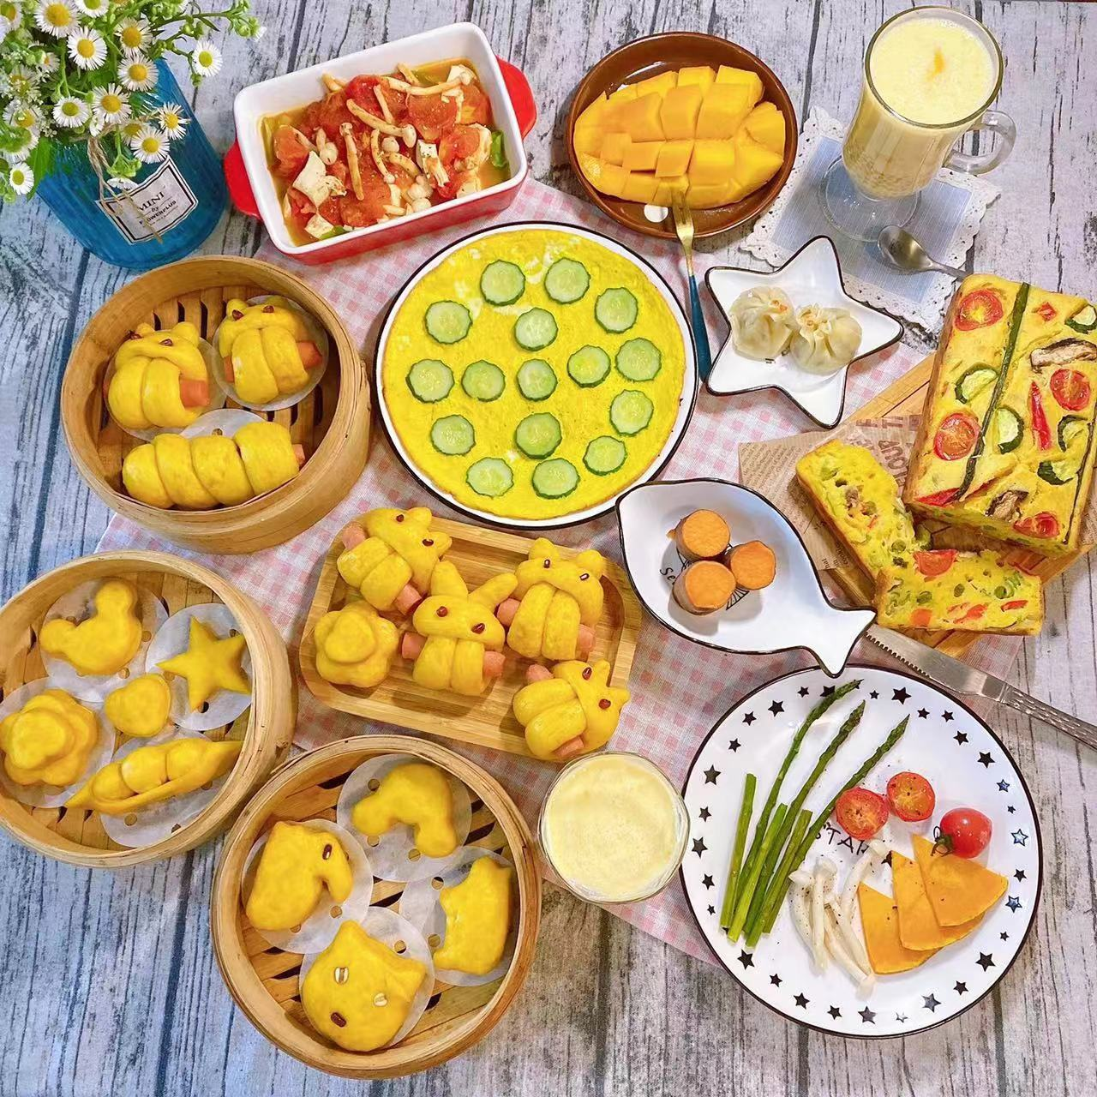
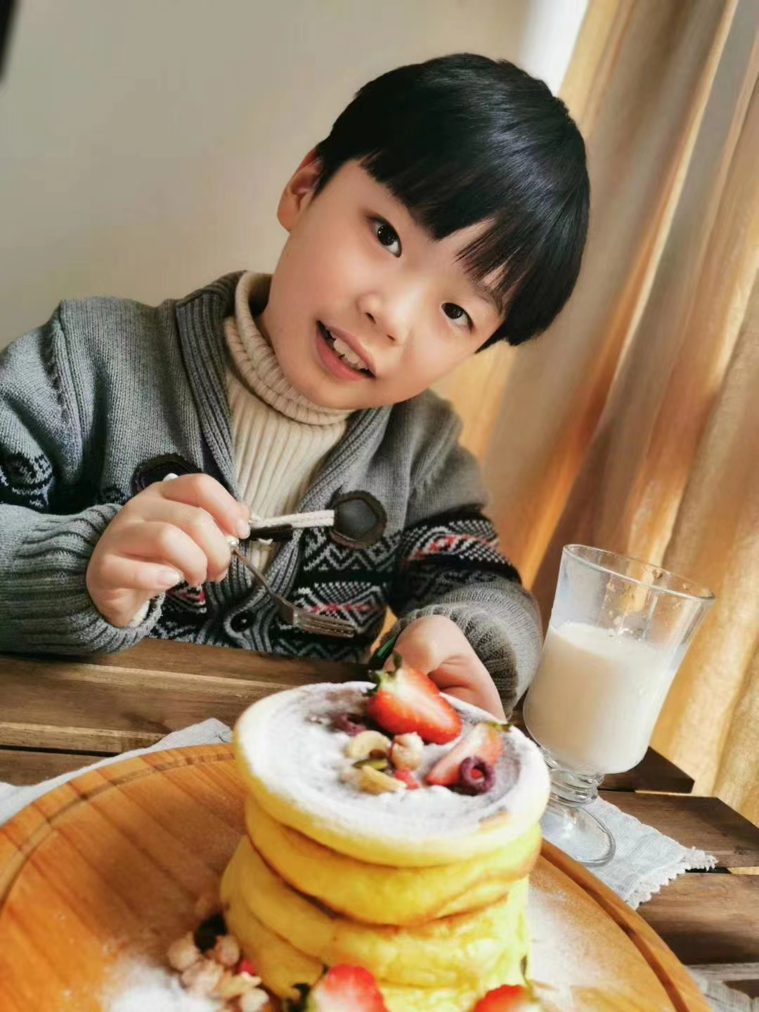
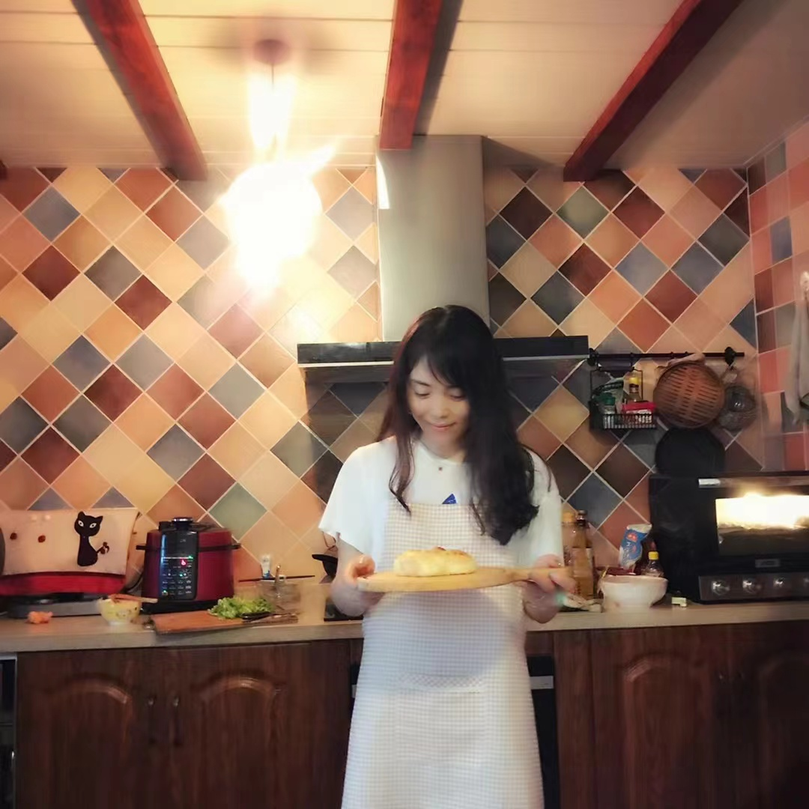
MOTHER
This is my mother.
She likes cooking.
She can cook many yummy foods.
I like eating them very much.

Slide 6
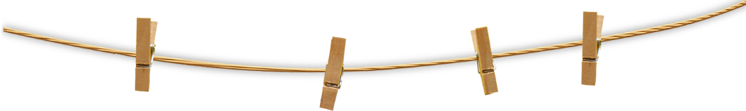
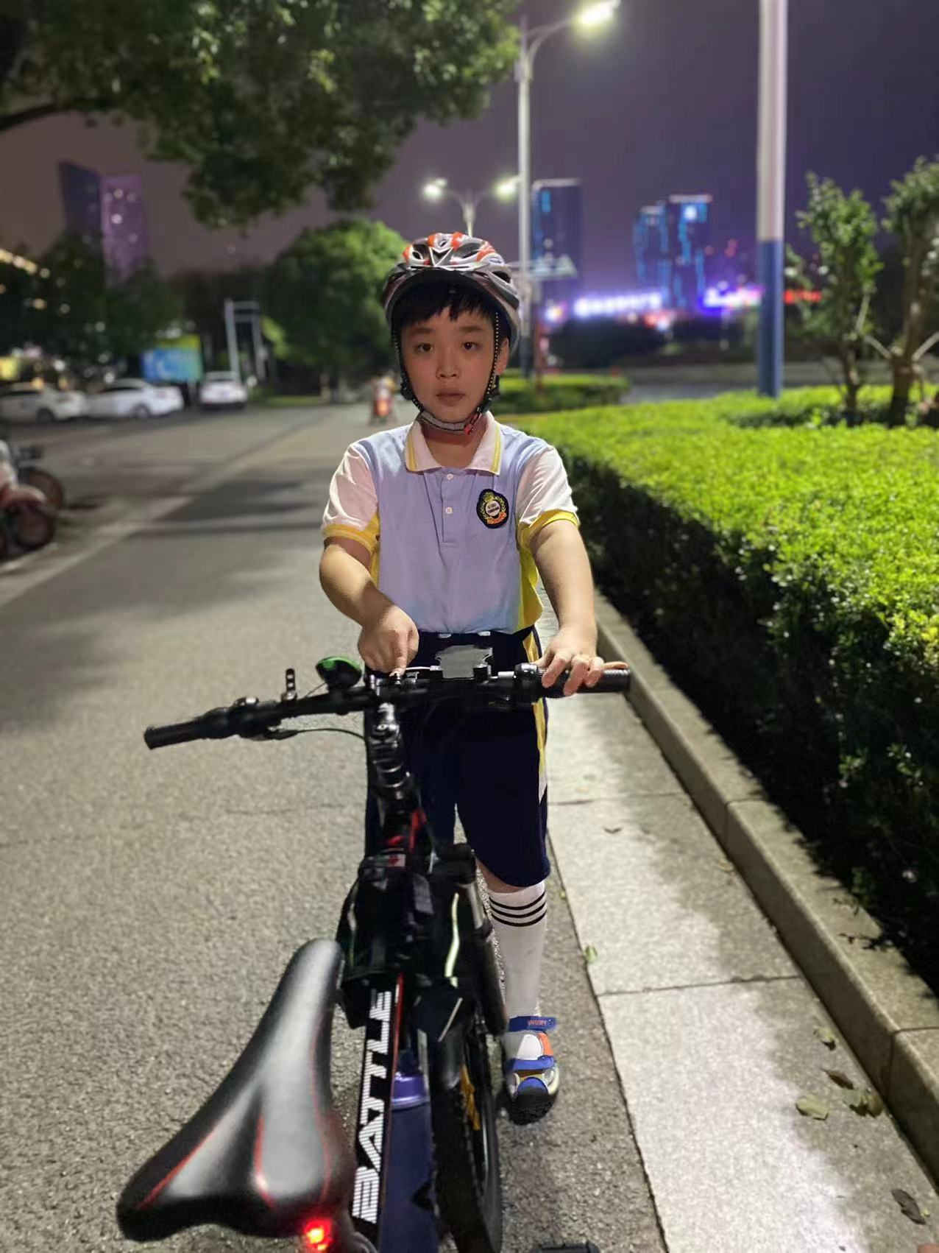
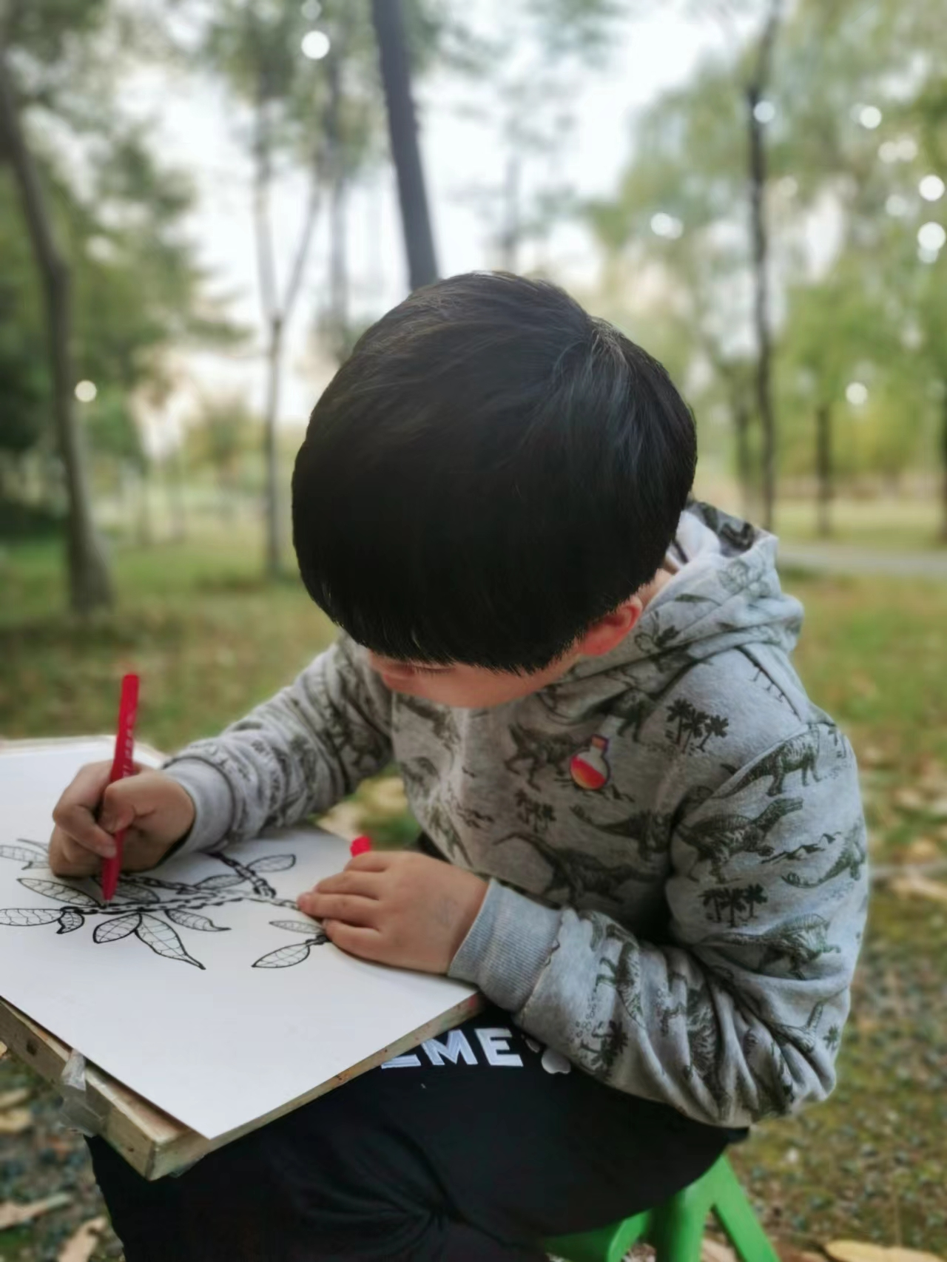
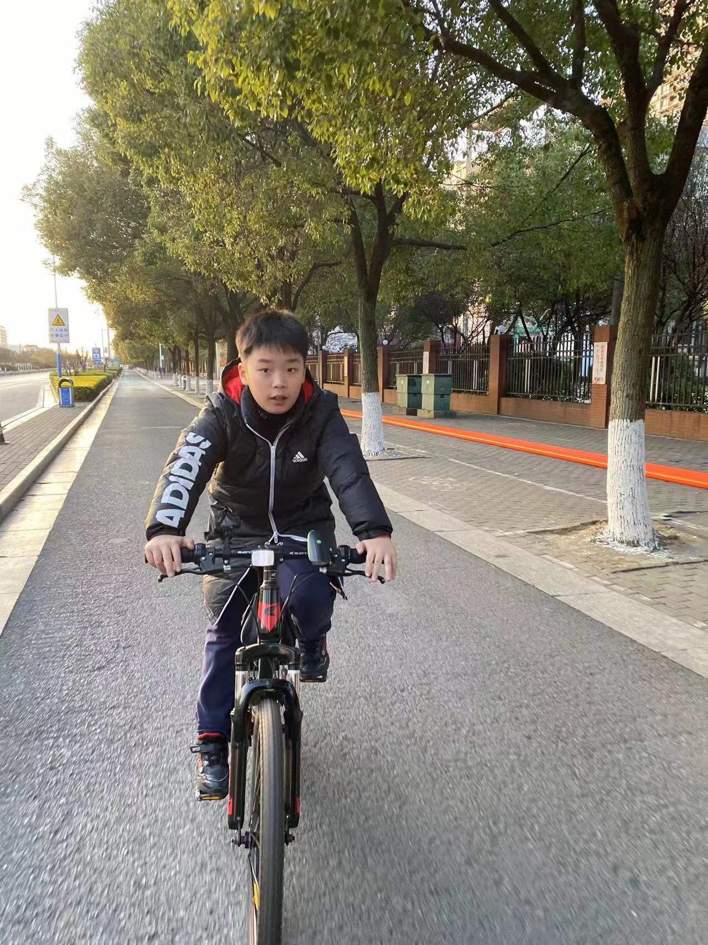
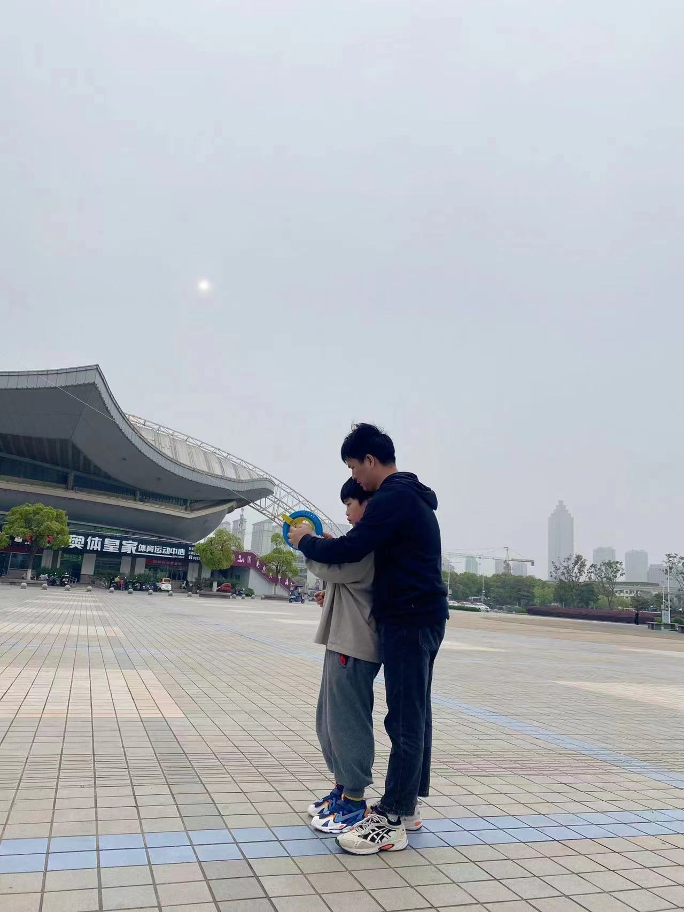

My Life

Slide 7
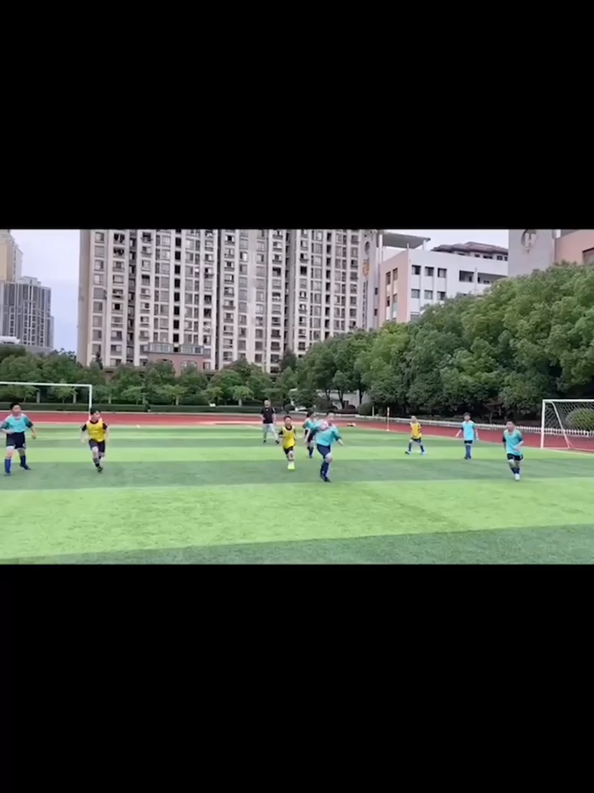
My Video

Slide 8
What do you think of my speech ?

